Slide 1
HTML Links and navigation

Slide 2
Summary of the previous lecture
What is HTML?
Basic Structure of HTML page
Body tag attributes
Text formatting tags
Lists

Slide 3
Outline
How to link between pages of your site (internal links)
How to link to other sites (external)
How to structure the folders on your web site
Internal document references
Link attributes

Slide 4
1. HTML links
The crux of HTML is its capability to reference countless other pieces of information easily on the internet
When you link to another page in your own web site, the link is known as an internal link
When you link to a different site, it is known as an external link

Slide 5
1.1 Internal links
The element <a> is used to link another document
Anything between the opening <a> tag and the closing </a> tag becomes part of the link that users can click in a browser

Slide 6
1.1 Internal links…
To link another page, href attribute of opening tag of <a> is used
the value of the href attribute is the name of the file you are linking to
For example:
<a href=“abc.html”> Click here </a>

Slide 7
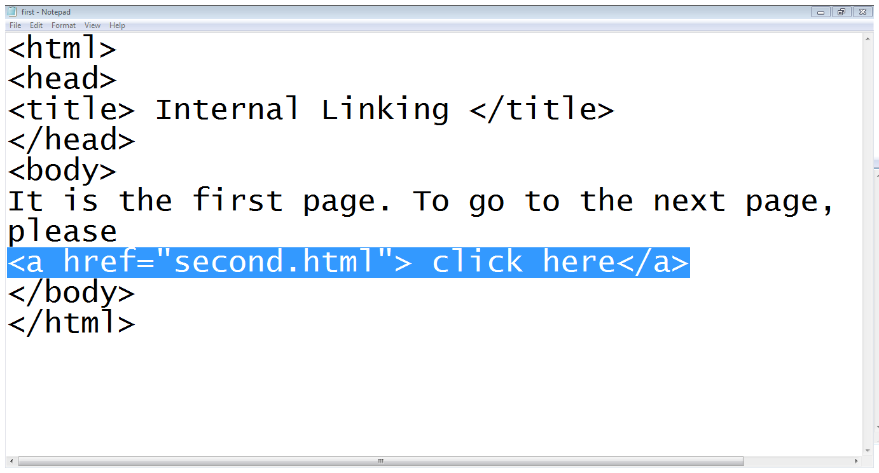
1.1 Internal links…

Slide 8
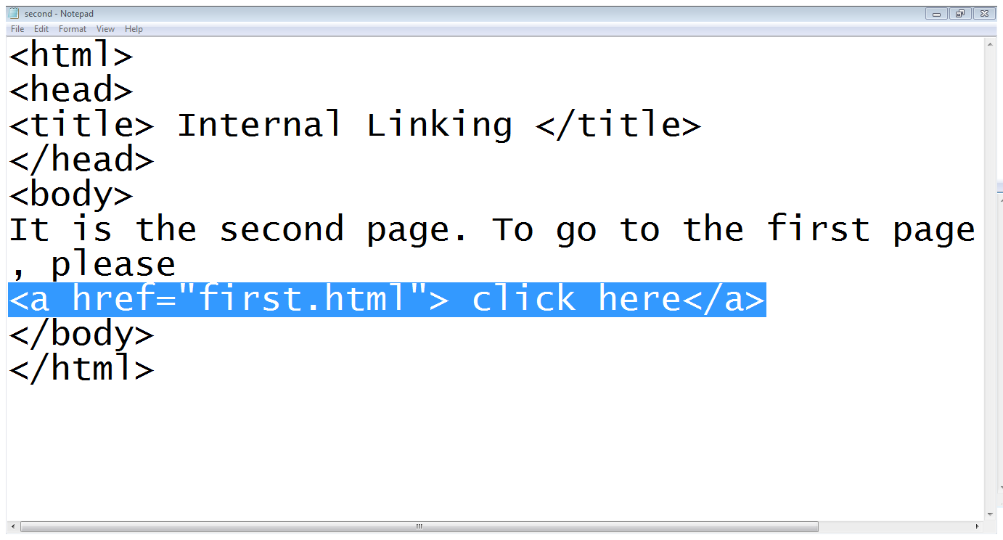
1.1 Internal links…

Slide 9
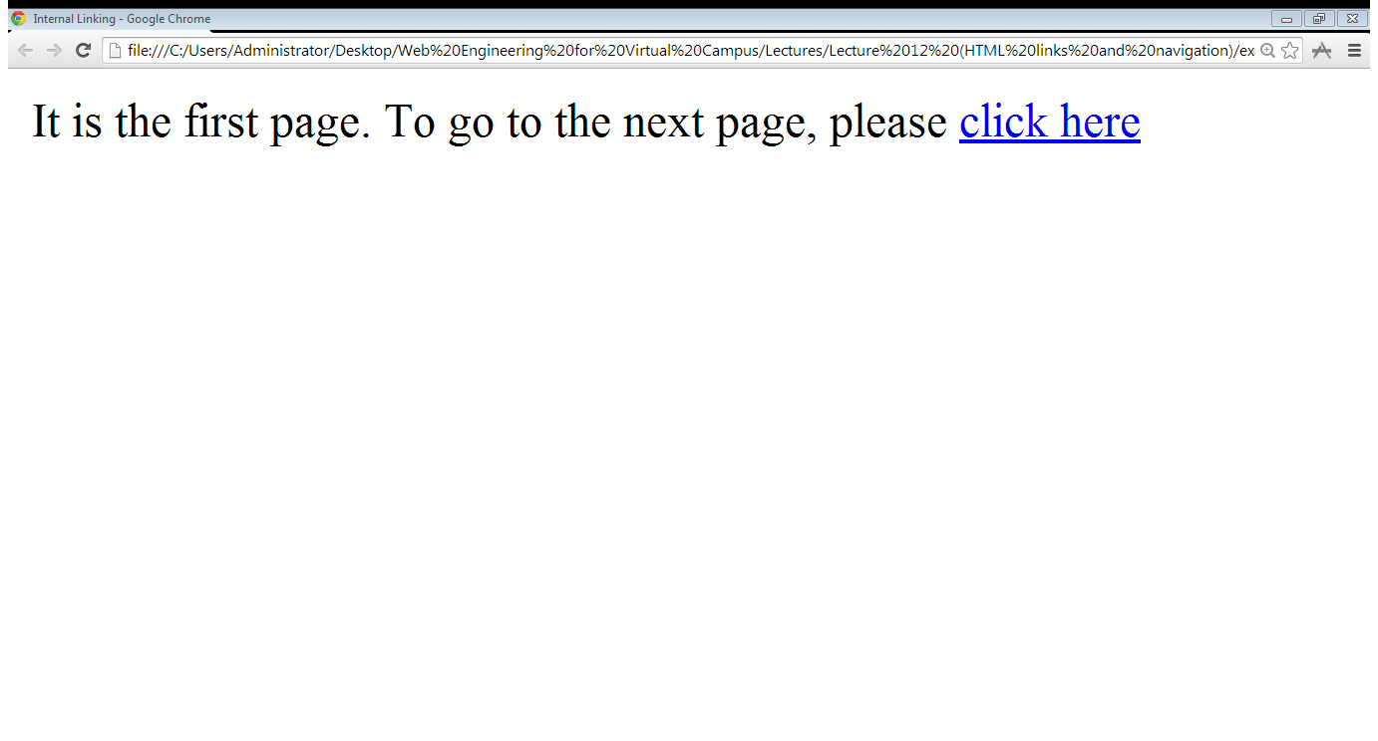
1.1 Internal links…

Slide 10
1.2 External links
To link the page of another website, again the href attribute of opening tag of <a> is used
the value of the href attribute is the full web address for the page you want to link to rather than just the filename
<a href="https://www.google.com.pk"> Click here </a>

Slide 11
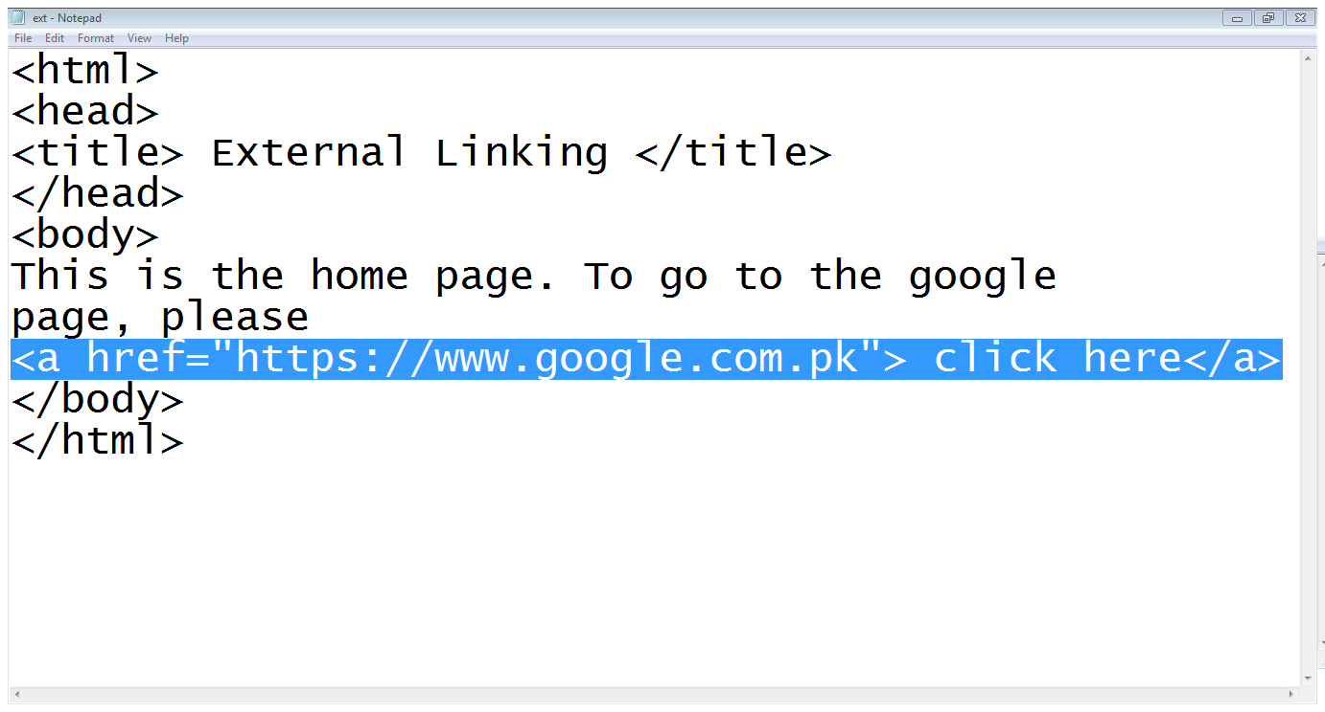
1.2 External links …

Slide 12
2. Directory Structures
A directory is simply another name for a folder on a web site
The root directory (or root folder) is the main directory that holds the whole of your web site
A subdirectory is a directory that is within another directory
A parent directory is a directory that contains another directory

Slide 13
2. Directory Structures…
Entertainment
index.html
Songs
audio.html
video.html
Videos
videos.html
Films
englishfilms.html
urdufilms.html

Slide 14
2.1 Referencing a web page
Same Directory: When you want to link to, or include, a resource from the same directory, you can just use the name of that file
Subdirectory:
sub-directory/…/file-name
Parent directory:
../file-name

Slide 15
2.1 Referencing a web page…
Entertainment
index.html
<a href=“englishfilms.html”>…..</a>
<a href=“Videos/Films/englishfilms.html”>….</a>
<a href=“../../Songs/audio.html”>….</a>
Songs
audio.html
video.html
Videos
videos.html
Films
englishfilms.html
urdufilms.html

Slide 16
3. Internal document references
Step 1: Mark locations
<A NAME=‘’LOCATION1”></A>
Step 2: link
<A HREF=“#LOCATION1”>……</A>

Slide 17
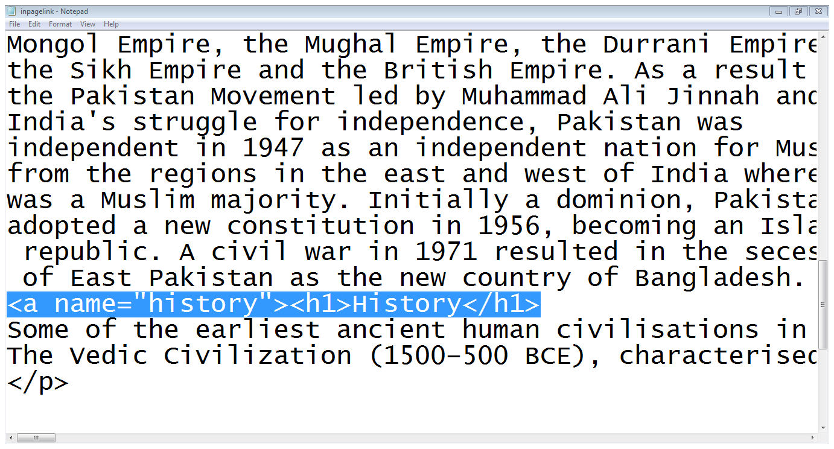
3. Internal document references

Slide 18
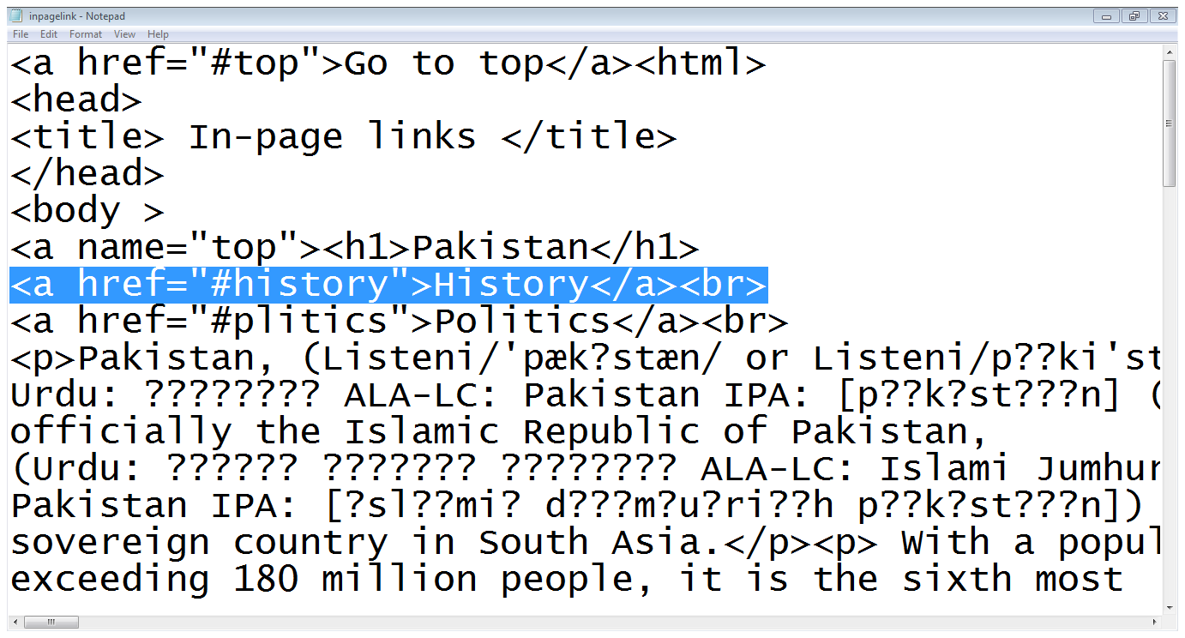
3. Internal document references

Slide 19
4. More attribute for <a>
accesskey:
<a href=“abc.html” accesskey=“a”>…..</a>
tabindex:
<a href=“abc.html” tabindex=“1”>….</a>
target:
<a href=“abc.html” target=“_blank”>….</a>
title:
<a href=“abc.html” title=“it,s a link”>….</a>

Slide 20
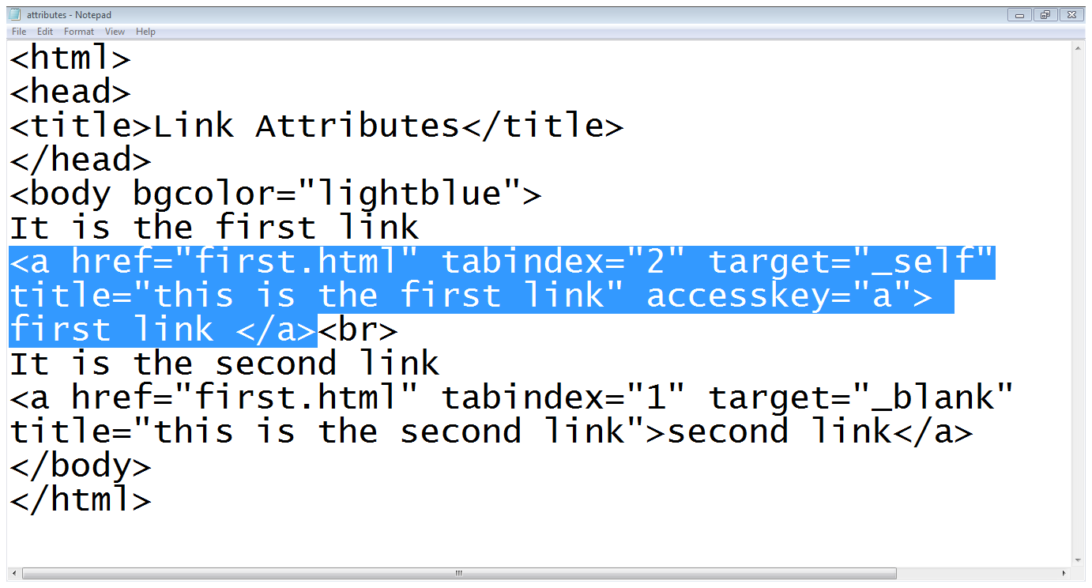
4. More attribute for <a>…

Slide 21
Summary
Internal links
External links
Directory Structure
Internal document reference
Some attributes of <a>

Slide 22
References
Chapter 2, Beginning HTML, XHTML,CSS, and JavaScript, by Jon Duckett, Wiley Publishing; 2009, ISBN: 978-0-470-54070-1.

